Slide 1


Manor Hill Brewery : Virginia Expansion
By:
Klift Li, Poppy He, Chuyang Yu, and Patrick Deans

Slide 2
Expansion Overview
Expansion Regulations
Legal Considerations
Potential Distributors
Potential Retail Locations

Slide 3
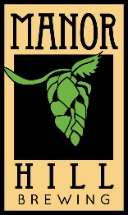

Expansion Regulations
Recommend using a distributor with an import license
Non-resident brewery license does not present significant advantages
Requires the following:
A Basic Permit from the Alcohol & Tobacco Tax and Trade Bureau (TTB)
ABC License
Product Label Approval with the Virginia ABC

Slide 4

Legal Considerations
Similar legal Structures
Maryland utilizes legal Articles and abides by state contract law
Virginia has a clearly defined Beer Franchise Act
VA more rigid in contract structure regarding termination (ABC approval)
Maryland has a 45-day notice period
Virgina has a 90-day notice period with a 60-day curing period

Slide 5

Potential Distributors
Northern Virginia
Virginia
Specialty Beverage
Hop & Wine
Ferment Nation
Select Wines, Inc
Premium Distributor of Virginia
Craft and Cellar

Slide 6

Potential Distributors
A part of Sheehan Family Company
Provide customized services: annual planning, inventory management, promotional programs, and market outreach
Current Maryland partnership: Manor Hill, Union Craft, Denizen’s, Duclaw, Flying Dog, Oliver, RaR

Slide 7
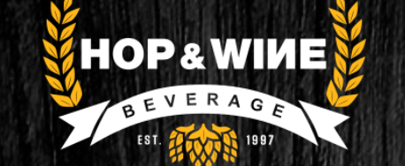
Potential Distributors
Have a market in Washington, D.C. (160+ brands)
Finely crafted products, highly-trained staff, and a safe work environment
Current Maryland partnership: Duclaw, Evolution Craft, Charm City Meadworks

Slide 8
Partnership Steps
Non-residence brewery license (if applicable)
Personalized partnership
TTB permission
Label and franchise approval from ABC

Slide 9
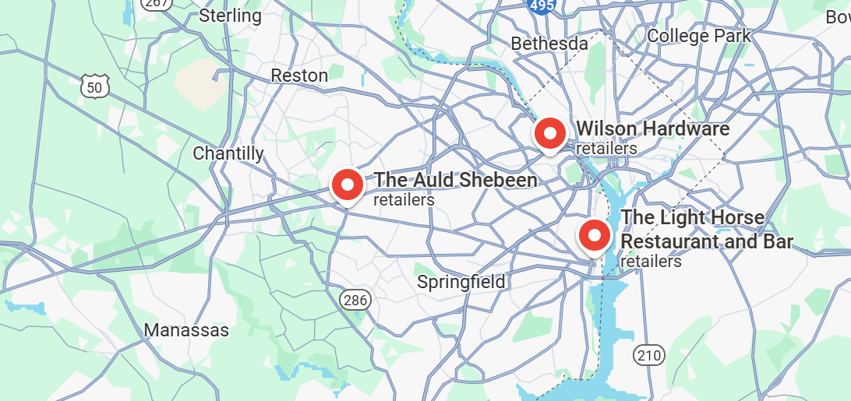
Potential Retailers-on premises

Slide 10

Potential Retailers-on premises
The Auld Shebeen
Fairfax
“Rotating Crafts” – open to new beer brands
Wilson Hardware
Arlington
“on tap” + “bottle” +Maryland IPA
The Light Horse
Alexandria
Accept non-local beer-style

Slide 11
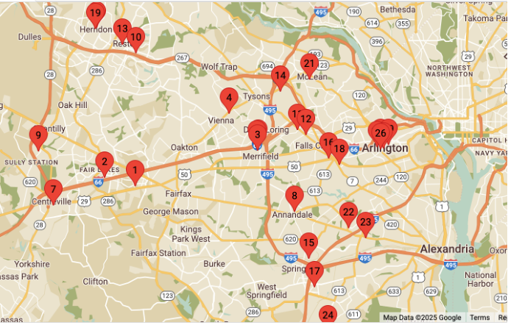
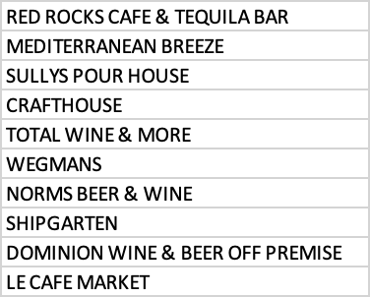
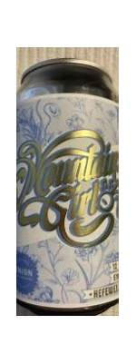
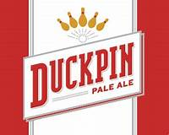
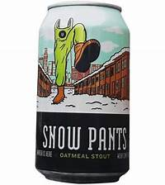

Competitors Analysis—Union Craft Brewery
Liquor Store
North Virginia

Slide 12
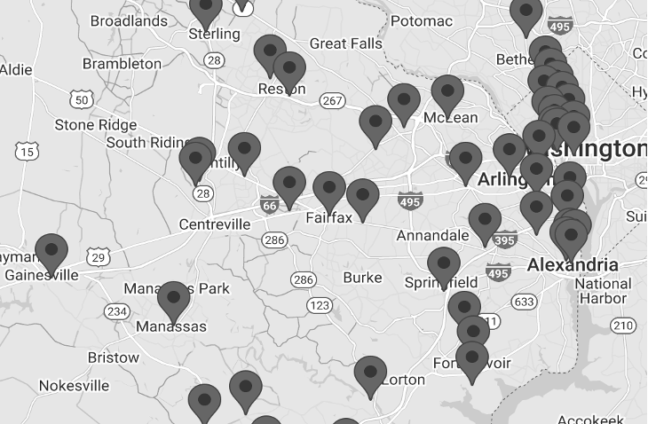
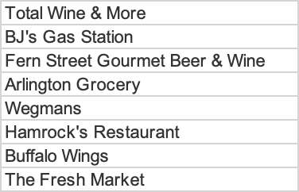
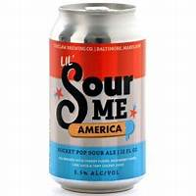
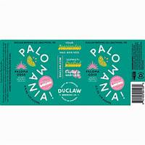
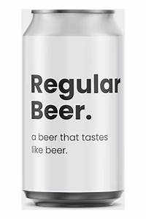
Competitors Analysis—DuClaw Brewing Co.
Gas Station& Restaurant
North Virginia

Slide 13
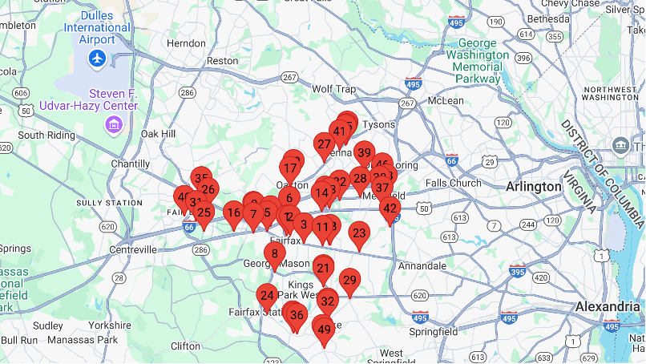
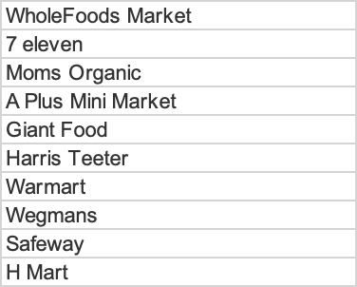
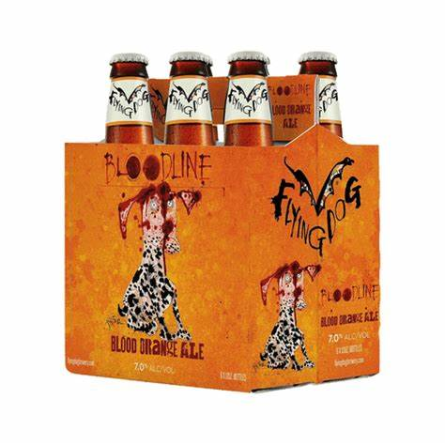
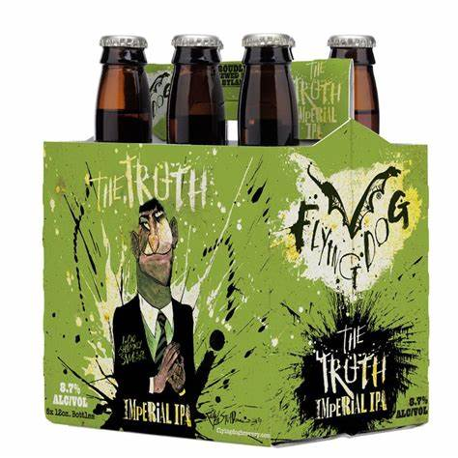
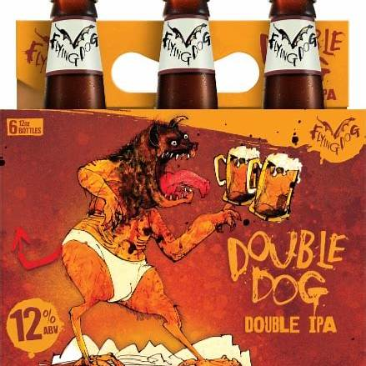
Competitors Analysis—Flying Dog Brewery
Grocery and convenience stores
wider range

Slide 14
Key Takeaway—competitor analysis
Region & stores
Major beer competitors have focused on Northern Virginia for expansion, likely due to drinking habits and geographic advantages. To stand out, we should avoid saturated areas like chain supermarkets, large convenience stores, and restaurants, instead targeting gas stations and smaller stores.
Beer Selection
Union offers diverse options, while DuClaw and Flying Dog focus on lagers and IPAs. Experimenting with Red Ale, Farmhouse Ale, or unique styles could create opportunities. Expansion could combine differentiated products in chain stores with a focus on smaller outlets.

Slide 15
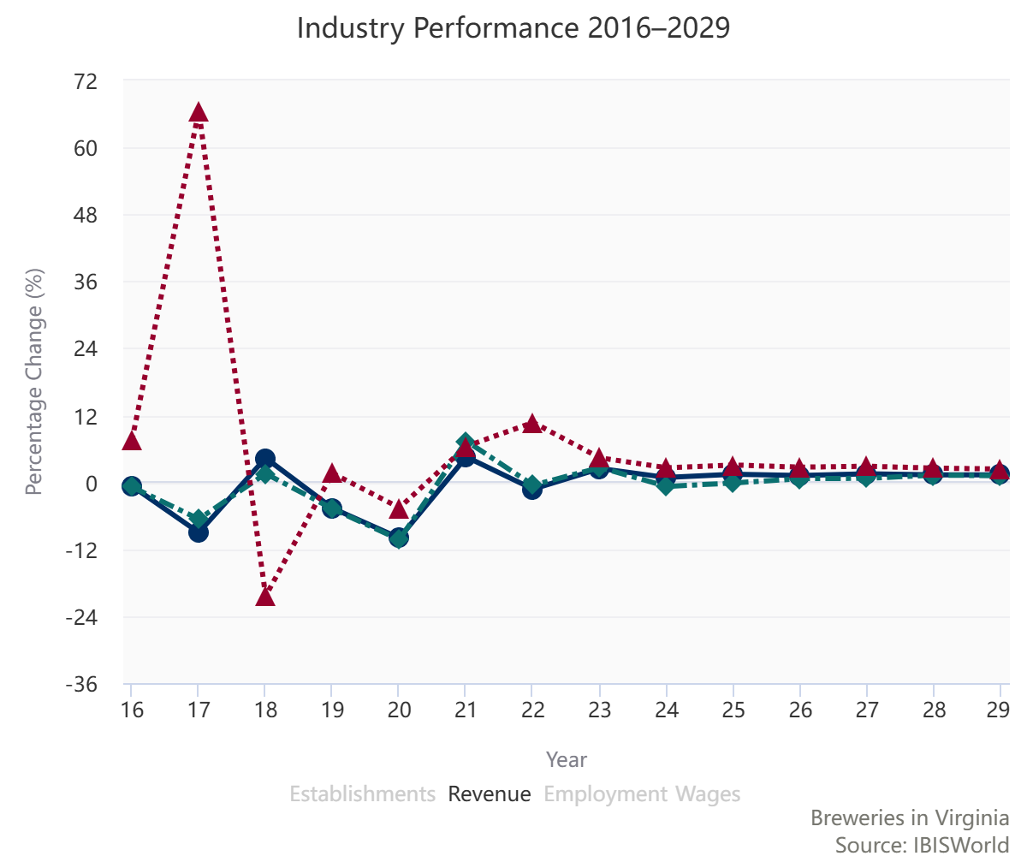

Overall Economic Landscape
539.1M USD
6.4% Growth Rate
362 Industrial Establishment

Slide 16
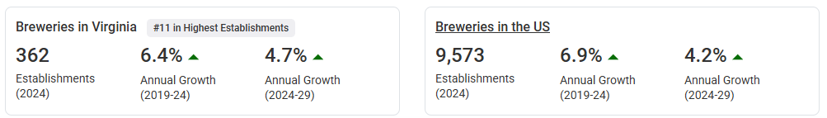
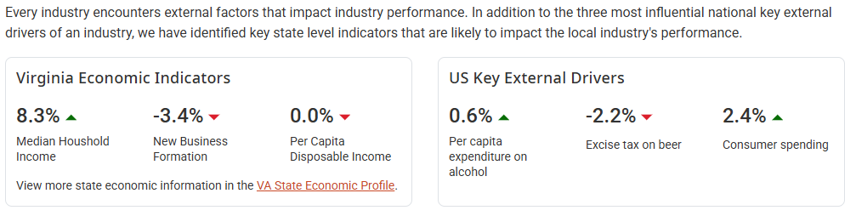
Overall Economic Landscape
Comparison
Key External Drivers

Slide 17
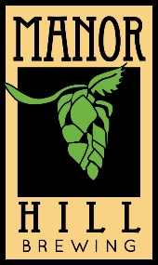
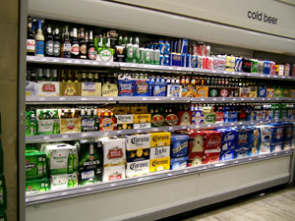
Retail and Shelf Space Competition
3 Main Challenges in Securing Shelf Space:
Retailer Prioritization: National chains often focus on high-volume products with proven sales records, which can disadvantage smaller breweries entering a new market.
Distribution Constraints: Distributors working with these retailers may have limited capacity or incentives to promote smaller, craft-focused brands, particularly those originating from out-of-state.
Consumer Familiarity: Virginia consumers may be less inclined to purchase out-of-state craft beer due to a strong preference for local products, driven by a "drink local" ethos.

Slide 18
Potential Retailers in VA
National Grocery Chains:
National Grocery Chains:
3. Convenience Stores:​
Kroger
Harris Teeter
Whole Foods Market
Trader Joe's
Wegmans​
Giant Food​
Food Lion
7-Eleven​
Sheetz​
Wawa
4. Local Bottle Shops:​
5. Specialty Retailers:​
Arrowine & Cheese​
Dominion Wine and Beer​
The Wine Cabinet
Norm's Beer & Wine
Total Wine & More​
ABC Stores (for associated products like cider or mead)

Slide 19
Obstacle 1: Retailer Prioritization of Larger Brands
​
Challenge: Retailers favor large, nationally recognized brands due to their high-volume sales and established consumer base.
Solution:
Pilot Programs: Propose limited-time pilot programs with key retailers, offering exclusive small-batch releases to test market reception.
Co-Branded Promotions: Partner with retailers for co-branded campaigns (e.g., seasonal beer bundles or themed promotions) to create unique value.
Data-Driven Pitch: Present consumer trend reports highlighting increased demand for craft and locally brewed beers, even out-of-state, to persuade retailers.

Slide 20
Obstacle 2: Distribution Constraints
​
Challenge: Distributors may prioritize larger brands, limiting smaller breweries' ability to penetrate the market.
Solution:
Niche Distributors: Partner with distributors specializing in craft beer, such as those already working with local breweries.
Incentive Structures: Negotiate favorable terms with distributors, such as sales-based incentives for promoting Manor Hill products.
Alternative Distribution Models: Explore direct-to-retail distribution in areas where self-distribution is allowed under Virginia law.

Slide 21
Obstacle 3: Consumer Preference for Local Products
​Challenge: Consumers in Northern Virginia may prefer local beers due to a "drink local" ethos, making it harder for out-of-state brands to compete.
Solution:
Brand Localization: Highlight ingredients sourced locally (if applicable) or emphasize the regional appeal of Manor Hill’s farm-to-table ethos.
Community Engagement: Host events, such as tap takeovers or charity collaborations, to build rapport with the local community and craft beer enthusiasts.
Tasting Events: Partner with retailers and bars to offer tastings, educating consumers on Manor Hill's unique offerings and encouraging trial purchases.

Slide 22
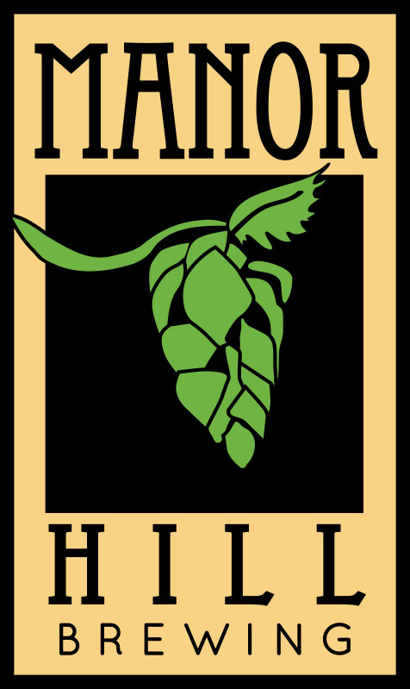
Acknowledgments!
Corey Mull
Rachel Mull
Randy Marriner
Len Foxwell
Satya Pramod Nagadamudi
Abhishek Survase

